Slide 1
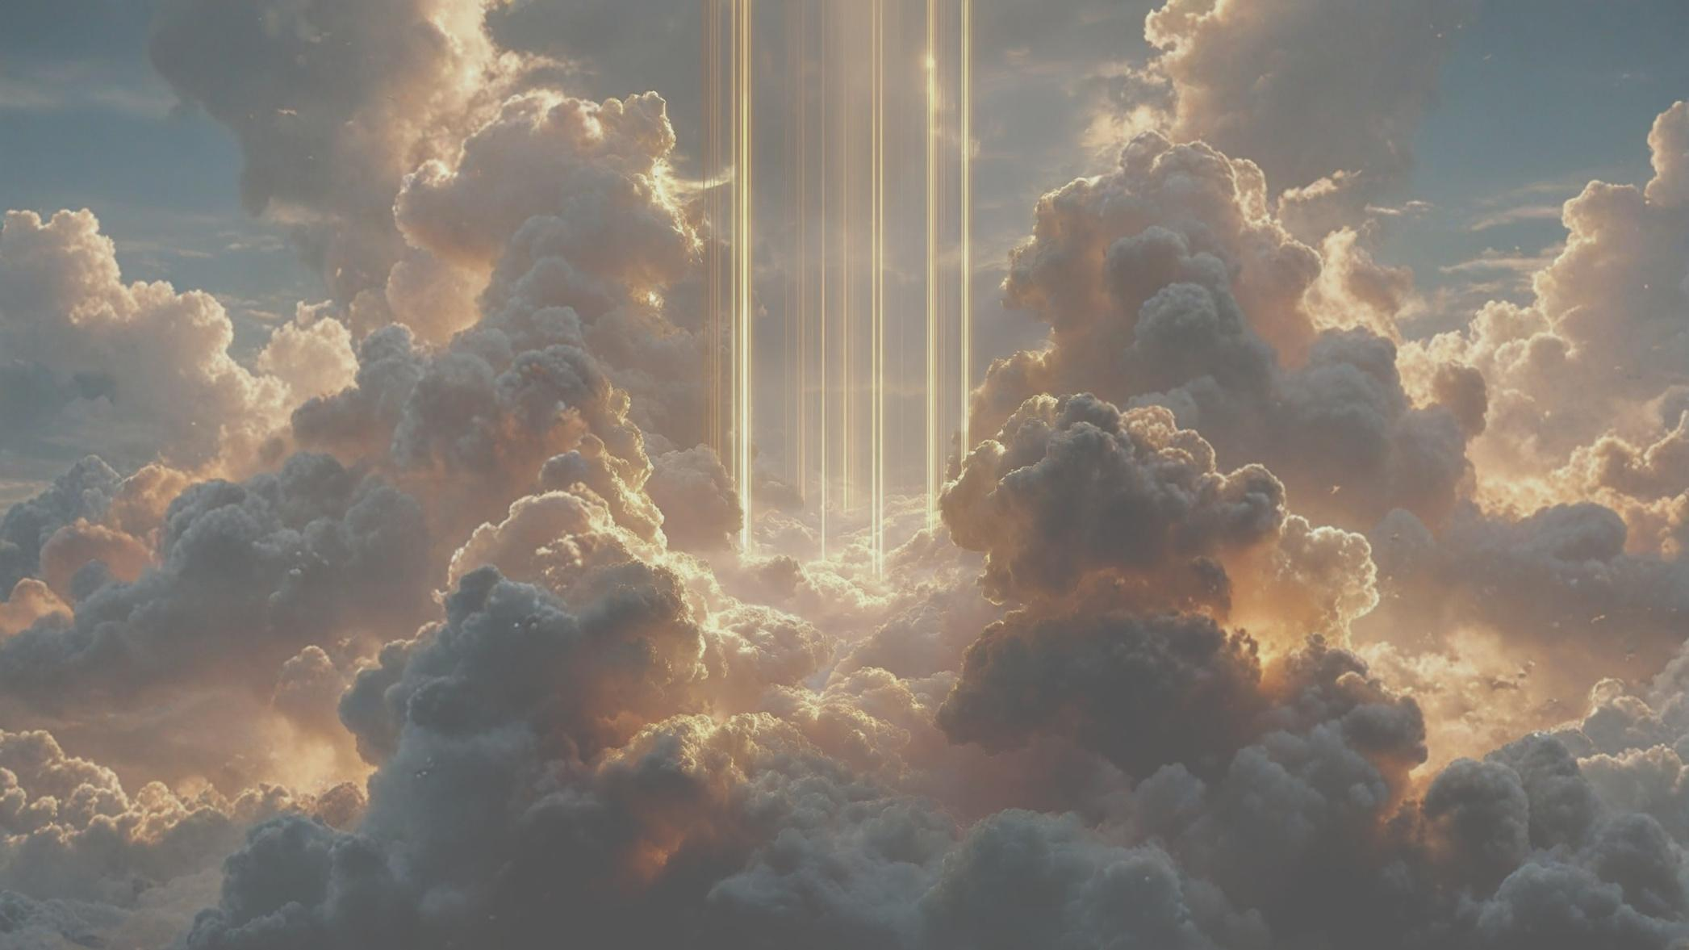

SEASON ONE · THE KINGDOM CREATED
KINGDOM COME
Week 1: God Creates
Genesis 1–2 · Psalm 8 · Colossians 1 · Revelation 21
Notes:
Week 1: God Creates — Leader's Guide.
Big Idea: God creates the world good and gives humanity its place in His story.

Slide 2
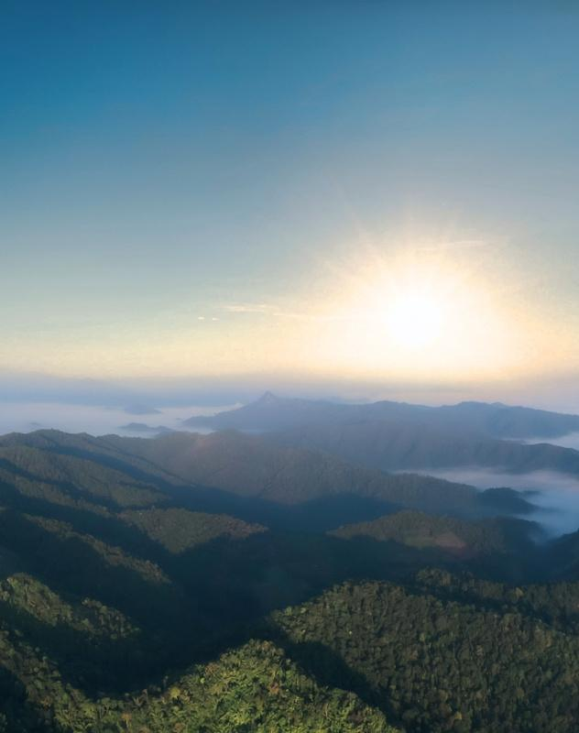
BIG IDEA
God creates the world good and gives humanity its place in His story.
OPENING QUESTION
If you could spend a day anywhere in God's creation, where would you go — and why?
KINGDOM COME / WEEK 1
Notes:
Opening question (full): If you could spend a day anywhere in God's creation (a mountain range, a beach, a forest, a lake, or somewhere else) where would you go and why?
Transition: "Every beautiful place we've mentioned points us back to a Creator. The Bible begins by introducing us to the God who made everything and gives meaning and purpose to our lives."

Slide 3
TONIGHT'S JOURNEY
From creation to new creation
1
2
3
4
5
The Story Begins with God
Humanity's Unique Place
Small People, Great Purpose
Jesus and Creation
Creation Restored
Genesis 1
Genesis 1:26–28; 2
Psalm 8
Colossians 1:15–20
Revelation 21:1–5
KINGDOM COME / WEEK 1
Notes:
Five movements tonight: Genesis 1 (God creates), Genesis 1–2 (humanity in His image), Psalm 8 (small people, great purpose), Colossians 1 (Jesus at the center of creation), Revelation 21 (creation restored).

Slide 4
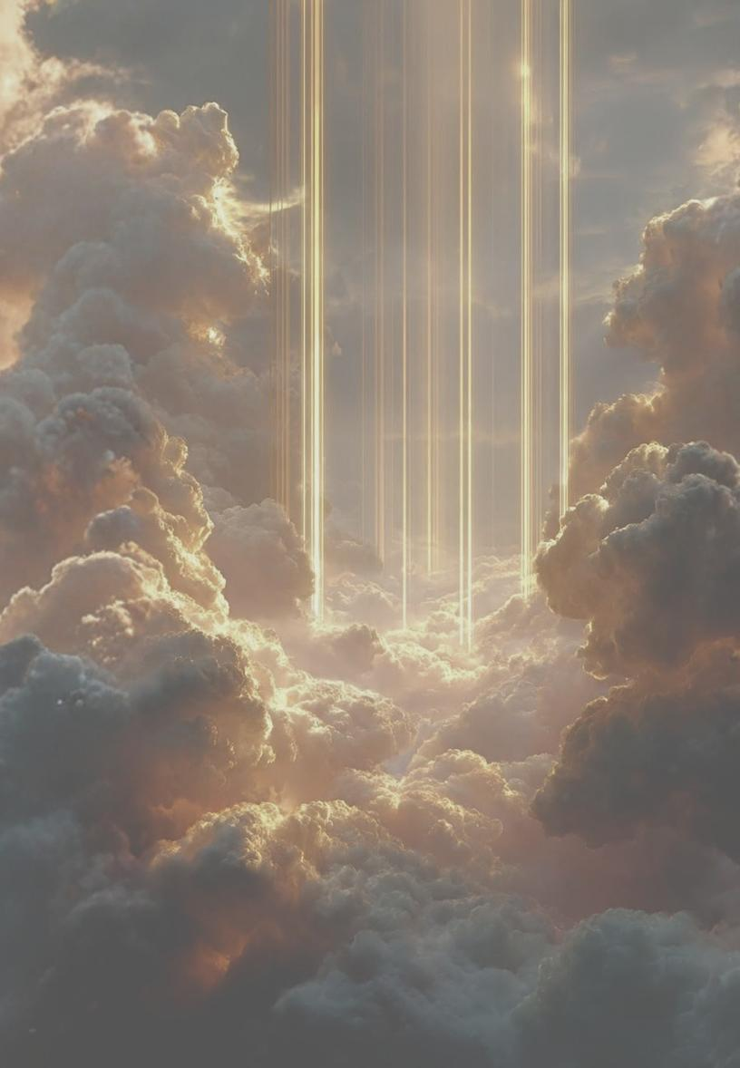
The Story Begins with God
“In the beginning, God created the heavens and the earth.”
The Bible begins with God, not with us
“And God saw that it was good”
Creation was designed, not accidental
Our lives have meaning because of His design
PART ONE
Genesis 1
KINGDOM COME / WEEK 1
Notes:
TALK TRACK
One of the most significant truths in all of Scripture is found in its opening words: "In the beginning, God created the heavens and the earth." Before we learn anything about humanity, sin, or redemption, we learn about God. The Bible begins with Him because He is the central character of the story. Everything that exists owes its existence to His creative power.
As Genesis 1 unfolds, we repeatedly hear "And God saw that it was good." This repetition is intentional. The world was not created by accident, nor was it originally flawed or broken. God designed creation with infinite wisdom, breathtaking beauty, and purpose. Although we live in a world affected by sin, God's original design was good — and we still see that goodness in nature, relationships, meaningful work, and countless other gifts.
If God created the world good, then our lives have meaning because they are rooted in His design. We are not random products of chance. We are part of a story that begins with a loving and purposeful Creator.
DISCUSSION
1. What are some ways you still see God's goodness reflected in creation?
2. How does believing the world was intentionally created affect how you view your life?

Slide 5
PART TWO · GENESIS 1:26–28; GENESIS 2
Humanity's Unique Place
Only people are made in God's image
Value
Identity
Purpose
Every person bears God's image
Worth comes from who made us
Show the world what God is like
Sin damaged the image — Jesus restores it
KINGDOM COME / WEEK 1
Notes:
TALK TRACK
Of everything God created, only human beings are described as being made in God's image. The sun reflects His glory, the mountains display His power, the oceans reveal His creativity — but people uniquely reflect something of who God is. Being made in God's image doesn't mean we look like God physically; it means we were designed to represent Him and reflect His character: to know, love, and worship God, to create, think, communicate, build relationships, make moral choices, and care for His creation.
VALUE — The image of God gives every person immense dignity: from the unborn child to the elderly adult, from the strongest to the weakest, from those who follow Christ to those who don't yet know Him. Every person has worth because every person bears God's image.
IDENTITY — Culture teaches us to find value in appearance, popularity, ability, achievements, possessions, relationships, or social media approval — things that can change. God gives something more secure: our value comes from who made us, not what we accomplish. Before Adam worked in the garden, God declared creation good. God loved us before we achieved anything.
PURPOSE — We are called to show others what God is like through the way we live, love, serve, forgive, create, and care for others.
Sin has damaged God's image in us but not erased it. This is why Jesus came — through His life, death, and resurrection He restores what sin has broken and transforms us to reflect God's character more clearly.
DISCUSSION
1. What is a way you saw the image of God reflected in a person this past week?
2. How does this truth influence the way we should treat other people?
3. How can knowing your identity is rooted in God bring freedom?

Slide 6
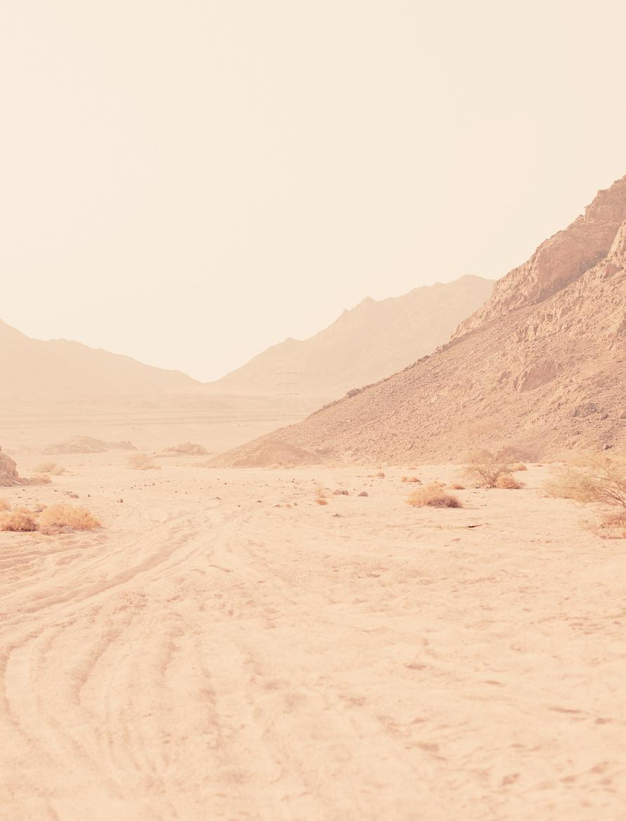
PART THREE · PSALM 8
Small People, Great Purpose
Vast heavens. Small people. A God who is mindful of us.
Pride
Insignificance
“It all revolves around me”
“My life doesn't matter”
Our significance comes from being known by God
KINGDOM COME / WEEK 1
Notes:
TALK TRACK
Psalm 8 captures a moment of worship and wonder. As David looks at the vastness of the night sky, he is overwhelmed by God's greatness. The stars remind him how small human beings really are. Yet instead of concluding that people are insignificant, David marvels that God is mindful of them and cares for them.
This passage protects us from two mistakes. On one hand, we can become prideful and believe everything revolves around us. On the other, we can feel insignificant and wonder whether our lives matter at all. Psalm 8 rejects both extremes: we are not the center of the universe, but neither are we forgotten by God. The Creator knows us, values us, and has given us a meaningful role within His creation.
In a culture where many struggle with identity and purpose, Psalm 8 reminds us that our significance comes from God's attention and love — not from our accomplishments, but from the fact that we are known by Him.
DISCUSSION
1. When have you been especially aware of God's greatness?
2. How does Psalm 8 encourage someone who feels insignificant? If you're a parent, how can the truths of Psalm 8 impact your parenting?

Slide 7
PART FOUR · COLOSSIANS 1:15–20
Jesus and Creation
“In him all things hold together.”
1
2
3
Before creation
Through & for Him
Holding all together
Christ existed before anything was made
All things created through Him, for Him
He actively sustains creation today
Life finds its greatest meaning surrendered to Him
KINGDOM COME / WEEK 1
Notes:
TALK TRACK
Many people think the story of Jesus begins in Bethlehem, but Colossians reveals that His role extends far beyond His earthly ministry. Paul teaches that Jesus is the image of the invisible God and that all things were created through Him and for Him. Before creation existed, Christ existed. In fact, He is the center of it.
Paul goes further: Jesus holds all things together. Every moment of history, every detail of creation, and every aspect of our lives depends on Him. The universe is not running on its own. The same Savior who died and rose again is actively sustaining His creation today.
This brings comfort and purpose. If everything was created through Christ and for Christ, then our lives find their greatest meaning when surrendered to Him. We were created to know Christ, worship Christ, and participate in His mission.
DISCUSSION
1. What stands out to you most in Colossians 1:15–20?
2. How does knowing Jesus created and sustains all things strengthen your faith?
3. How should this truth impact our daily life?

Slide 8
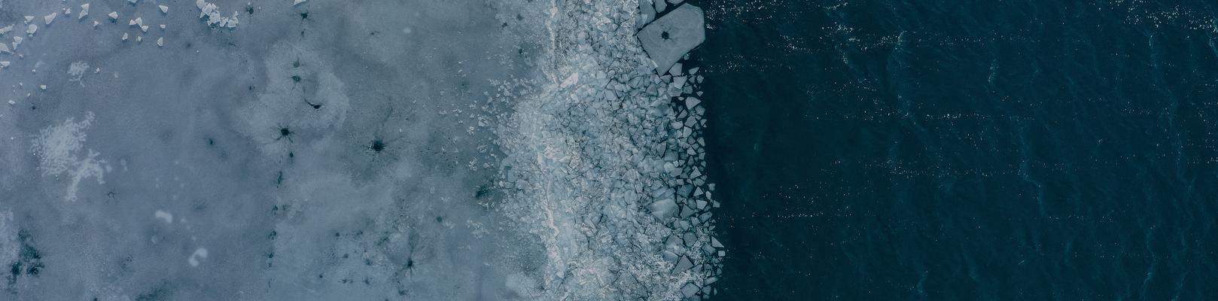
PART FIVE · REVELATION 21:1–5
Creation Restored
“Behold, I am making all things new.”
Full circle
Not rescue — renewal
Hope for today
From garden to new creation
God is making all things new
Realistic, but never hopeless
KINGDOM COME / WEEK 1
Notes:
TALK TRACK
The Bible begins with creation in Genesis and ends with creation restored in Revelation. God's plan is not simply to rescue people from a broken world; His plan is to make all things new. Revelation paints a picture of a renewed creation where sin, suffering, death, and pain are finally removed.
One of the most encouraging statements in Scripture: "Behold, I am making all things new." The story that began in a perfect garden will end with a restored creation where God's people dwell with Him forever.
This future hope changes how we live today. Christians are realistic about the brokenness of the world, but we are not hopeless. God is moving history toward restoration. Every act of faithfulness, every expression of love, and every effort to follow Christ points forward to the day when His kingdom is fully realized.
DISCUSSION
1. What part of Revelation 21 gives you the most hope?
2. How does knowing the end of the story affect how you face present struggles?

Slide 9
CLOSING
Five Key Truths
1
2
3
4
5
God Is the Creator of Everything
Creation Was Made Good
Humanity Is Made in God's Image
Jesus Is the Center of Creation
God Is Restoring All Things
Author of the story
Reflects His goodness
Belonging to Him
Through Him, for Him
Not the final word
KINGDOM COME / WEEK 1
Notes:
TALK TRACK
1. God Is the Creator of Everything — The Bible begins with God. Everything that exists came from Him, belongs to Him, and points back to Him. Life is not an accident and history is not random. God is the Author of the story.
2. Creation Was Made Good — When God finished His work, He declared it "very good." The beauty, order, and wonder we see reflect God's wisdom and goodness. Sin has brought brokenness, but creation still bears witness to the goodness of its Creator.
3. Humanity Is Made in God's Image — Every person has dignity, value, and purpose because they were created by God. Our identity is not rooted in accomplishments, appearance, possessions, or popularity, but in belonging to Him.
4. Jesus Is the Center of Creation — Jesus is not merely part of God's story; He is the center of it. All things were created through Him, for Him, and are sustained by Him.
5. God Is Restoring All Things — The story that begins in Genesis ends in Revelation with God making all things new. The brokenness we experience today will not have the final word.
As you think about these five truths, which one do you most need to remember this week?

Slide 10





REFLECT
Which truth do you most need this week?
God is in control as Creator
God is good, even in a hard season
Your identity is in being made in God's image
An area of your life needs to be surrendered to Jesus
God is making all things new
KINGDOM COME / WEEK 1
Notes:
Ask the group: which of these do you most need to remember this week?
• Do you need to remember that God is in control as Creator?
• Do you need to be reminded of God's goodness in a difficult season?
• Do you need to find your identity again in being made in God's image?
• Do you need to surrender an area of your life to Jesus, the center of the story?
• Do you need hope from the promise that God is making all things new?

Slide 11
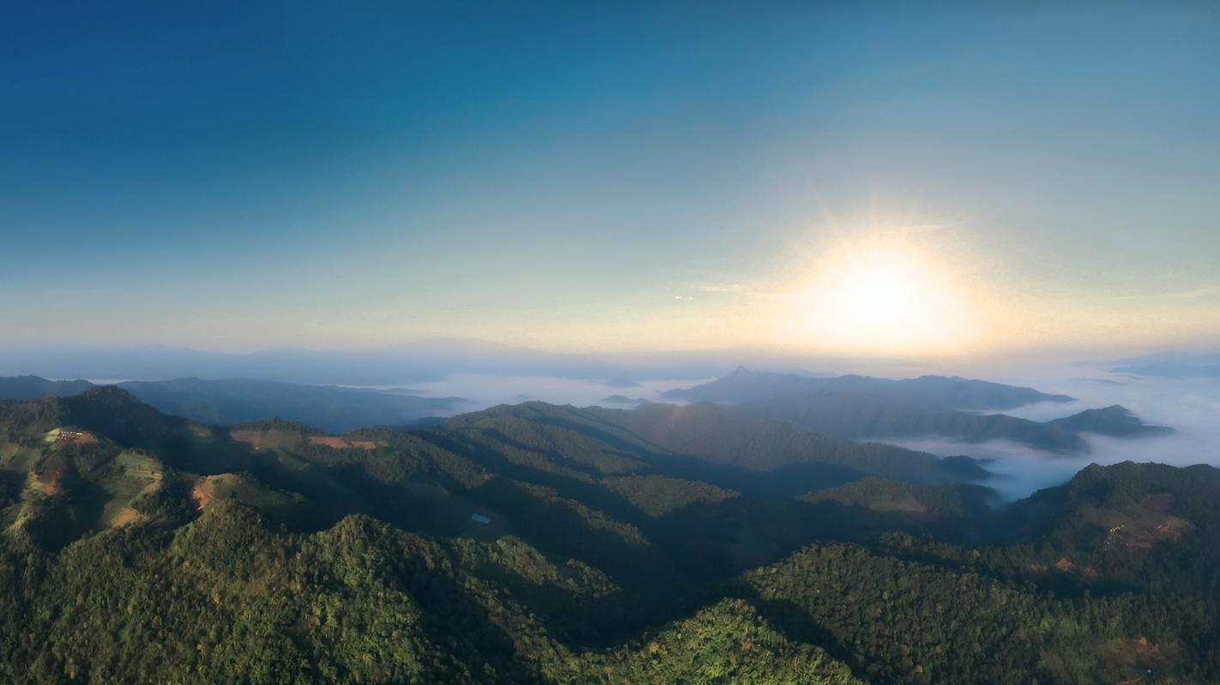
FINAL CHALLENGE
One practical step this week
…to live in light of the truth that God created you and gave you a place in His story.
Notes:
Final Challenge (full): What is one practical step you can take this week to live more intentionally in light of the truth that God created you and has given you a place in His story?

Slide 12

KEEP GOING · WEEK ONE READING PLAN
This week: God Creates
MON
TUE
WED
THU
FRI
Genesis 1
Genesis 2
Psalm 8
Colossians 1
Revelation 21
USE THIS SIMPLE PROCESS WITH EACH DAY'S READING
Read
Reflect
Believe
Desire
Do
Pray
The day's passage
What is God showing me?
What truth do I trust?
What should I long for?
What action do I take?
Ask Him to help you live it
KINGDOM COME / WEEK 1
Notes:
Reading plan process (full text):
Read — Read the assigned Scripture passage.
Reflect — What does God want me to see about Himself, His people, or His plan?
Believe — What promise, truth, or aspect of God's character should I trust today?
Desire — What should I love, value, pursue, or long for?
Do — What actions should I take or changes should I make in my life?
Pray — Talk to God about what you have learned and ask Him to help you live it out.

Slide 13
KEEP GOING · WEEK TWO READING PLAN · SEPT 7–11
Next week: We Rebel
MON
TUE
WED
THU
FRI
Genesis 3
Genesis 4
Genesis 6:1–8
Romans 5
Ephesians 2
USE THIS SIMPLE PROCESS WITH EACH DAY'S READING
Read
Reflect
Believe
Desire
Do
Pray
The day's passage
What is God showing me?
What truth do I trust?
What should I long for?
What action do I take?
Ask Him to help you live it
KINGDOM COME / WEEK 1
Notes:
Week Two (Sept 7–11): We Rebel — Genesis 3, Genesis 4, Genesis 6:1-8, Romans 5, Ephesians 2.
Reading plan process (full text):
Read — Read the assigned Scripture passage.
Reflect — What does God want me to see about Himself, His people, or His plan?
Believe — What promise, truth, or aspect of God's character should I trust today?
Desire — What should I love, value, pursue, or long for?
Do — What actions should I take or changes should I make in my life?
Pray — Talk to God about what you have learned and ask Him to help you live it out.

